Slide 1
Object Oriented Programming—C++ Lecture7 Classes (II)
Qijun Zhao
College of Computer Science
Sichuan University
Spring 2023

Slide 2
Contents
1. C++ Classes Introduction
1.1 class vs. struct
1.2 Data members and Function Members
1.3 RAII and Smart Pointers
2. Class Hierarchy
2.1 Access Specifiers
2.2 Inheritance Access Specifiers
3. Class Constructor and Destructor
3.1 Intro
3.2 Default Constructor
3.3 Class Initialization
3.4 Constructors and Inheritance
3.5 Delegate Constructor
3.6 explicit Keyword
3.7 Copy Constructor
3.8 Move Constructor

Slide 3
1. C++ Classes Introduction
1.1 class vs. struct
C/C++ Structure
A structure (struct) is a collection of variables of the same or different data types under a single name
C++ Class
A class (class) extends the concept of structure to hold functions as members
struct vs. class
Structures and classes are semantically equivalent. In general, struct represents passive objects, while class active objects

Slide 4
1.2 Class Members - Data and Function Members
Data Member
Data within a class are called data members or class fields
Function Member
Functions within a class are called function members or methods

Slide 5
1.3 RAII and Smart Pointers
1.3.1 RAII Idiom - Resource Acquisition is Initialization
Holding a resource is a class invariant, and is tied to object lifetime
RAII Idiom consists in three steps:
• Encapsulate a resource into a class (constructor)
• Use the resource via a local instance of the class
• The resource is automatically released when the object gets out of scope
(destructor)
Implication 1: C++ programming language does not require the garbage collector!!
Implication 2: The programmer has the responsibility to manage the resources

Slide 6
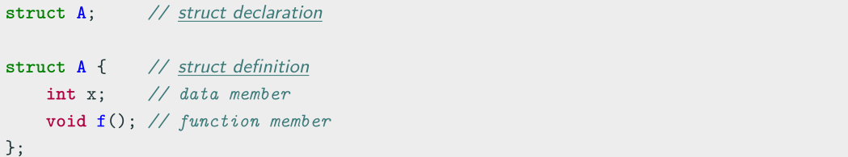
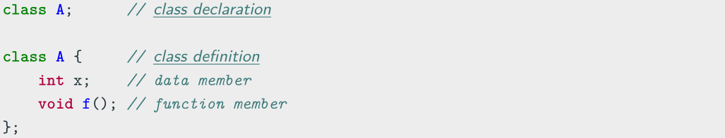
struct/class Declaration and Definition
struct declaration and definition
class declaration and definition

Slide 7
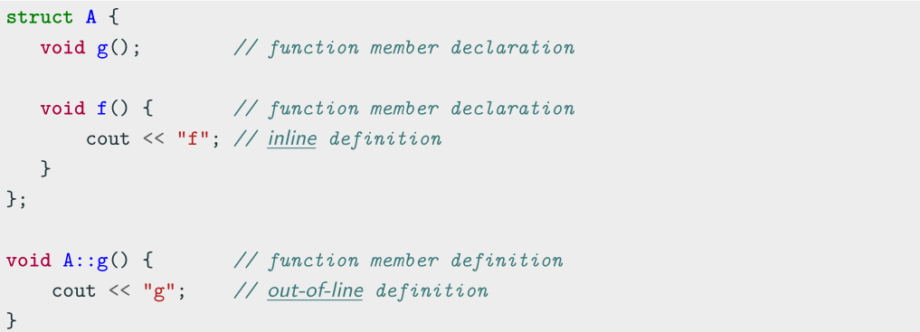
struct/class Function Declaration and Definition

Slide 8
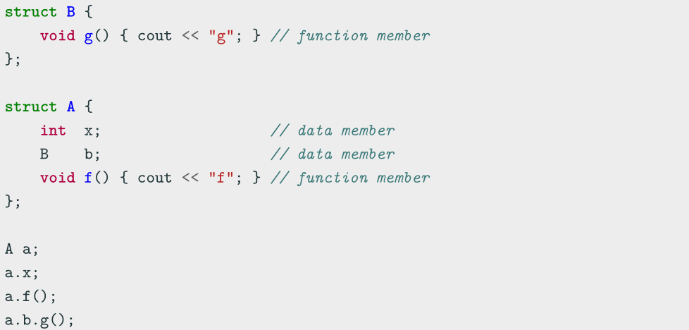
struct/class Members

Slide 9
1.3.2 Smart pointers
Smart pointer is a pointer-like type with some additional functionality, e.g. automatic
memory deallocation (when the pointer is no longer in use, the memory it points to is
deallocated), reference counting, etc.
C++11 provides three smart pointer types:
• std::unique ptr
• std::shared ptr
• std::weak ptr
Smart pointers prevent most situations of memory leaks by making the memory
deallocation automatic

Slide 10
Smart Pointers Benefits
• If a smart pointer goes out-of-scope, the appropriate method to release resources
is called automatically. The memory is not left dangling
• Smart pointers will automatically be set to nullptr if not initialized or when
memory has been released
• std::shared_ptr provides automatic reference count
• If a special delete function needs to be called, it will be specified in the pointer
type and declaration, and will automatically be called on delete

Slide 11
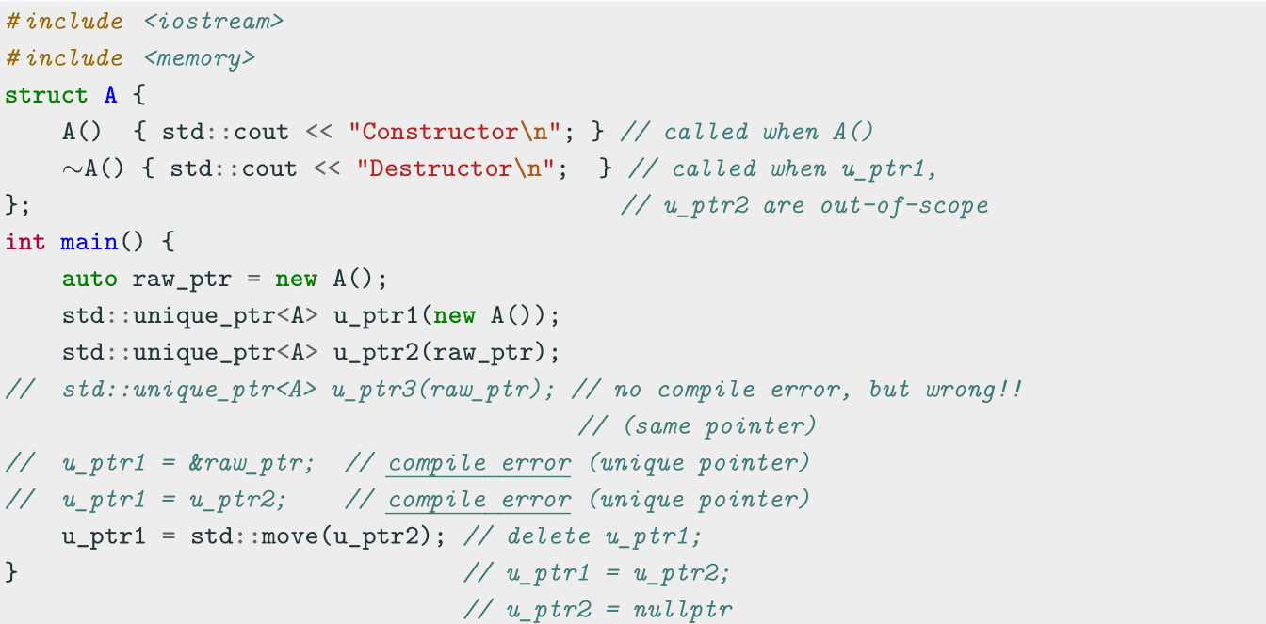
std::unique ptr - Unique Pointer
std::unique_ptr is used to manage any dynamically allocated object that is not shared by multiple objects

Slide 12
std::unique ptr - Unique Pointer
std::unique_ptr methods
• get() returns the underlying pointer
• operator* operator-> dereferences pointer to the managed object
• operator[] provides indexed access to the stored array (if it supports random
access iterator)
• release() returns a pointer to the managed object and releases the ownership
• reset(ptr) replaces the managed object with ptr
Utility method: std::make unique<T>() creates a unique pointer of a class T
that manages a new object

Slide 13
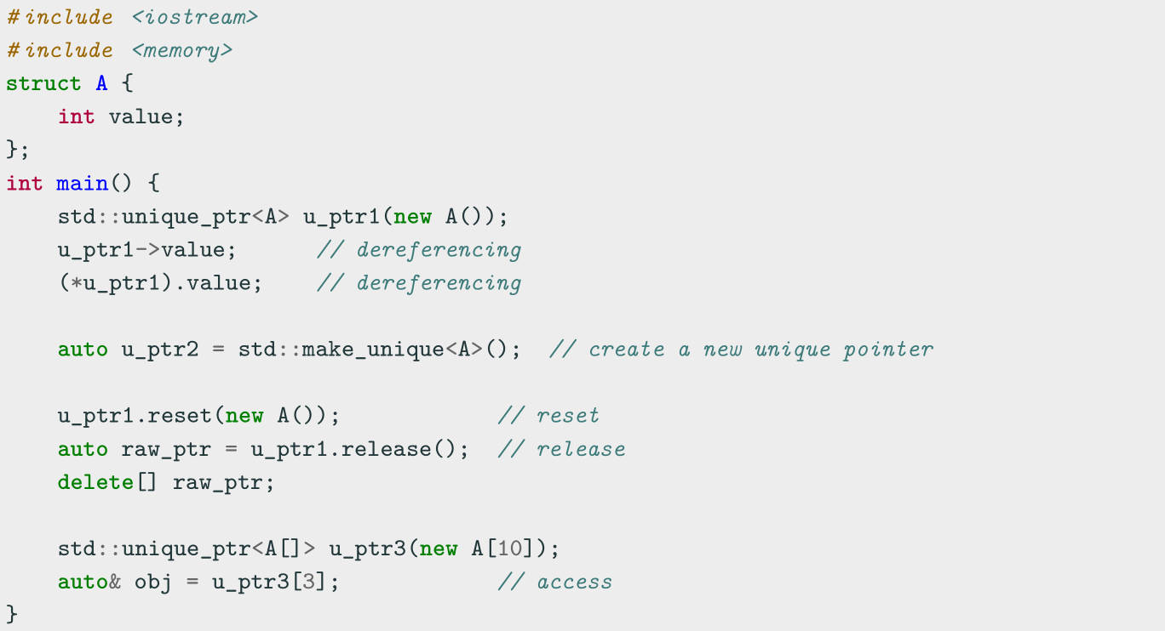
std::unique ptr - Unique Pointer

Slide 14
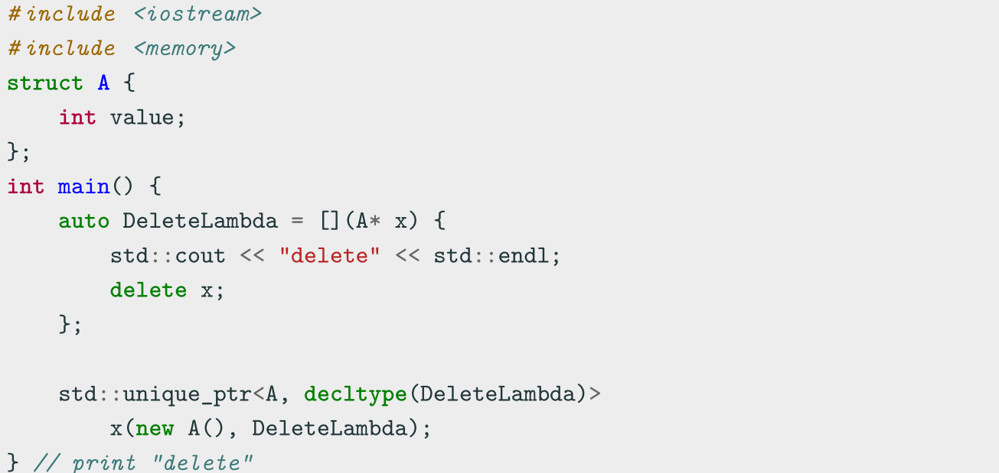
std::unique ptr - Unique Pointer
Implement a custom deleter

Slide 15
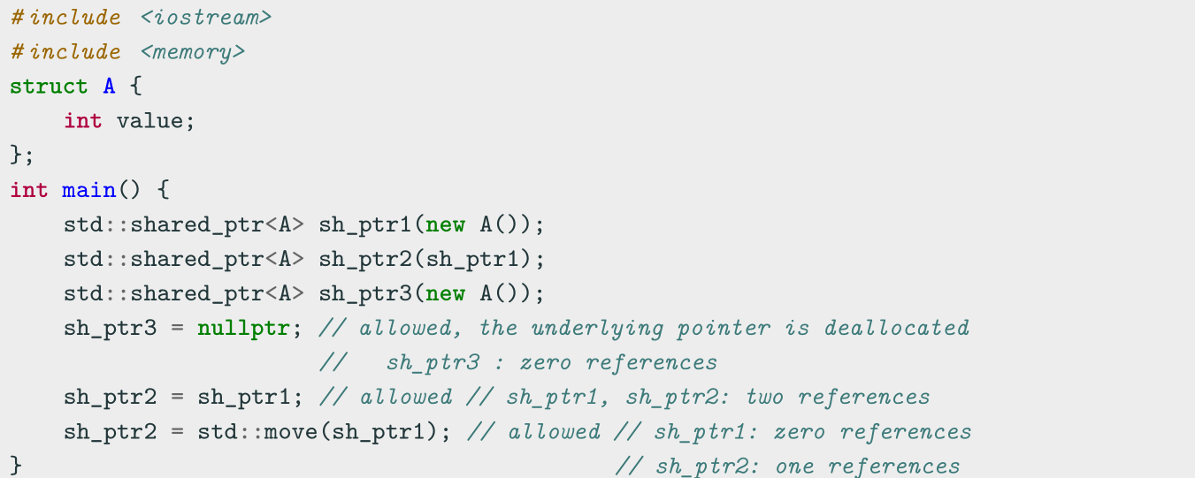
std::shared ptr - Shared Pointer
std::shared ptr is the pointer type to be used for memory that can be owned by multiple resources at one time
std::shared ptr maintains a reference count of pointer objects. Data managed by
std::shared ptr is only freed when there are no remaining objects pointing to the data

Slide 16
std::shared ptr - Shared Pointer
std::shared ptr methods
• get() returns the underlying pointer
• operator* operator-> dereferences pointer to the managed object
• use count() returns the number of objects referring to the same managed object
• reset(ptr) replaces the managed object with ptr
Utility method: std::make shared() creates a shared pointer that manages a new
object

Slide 17
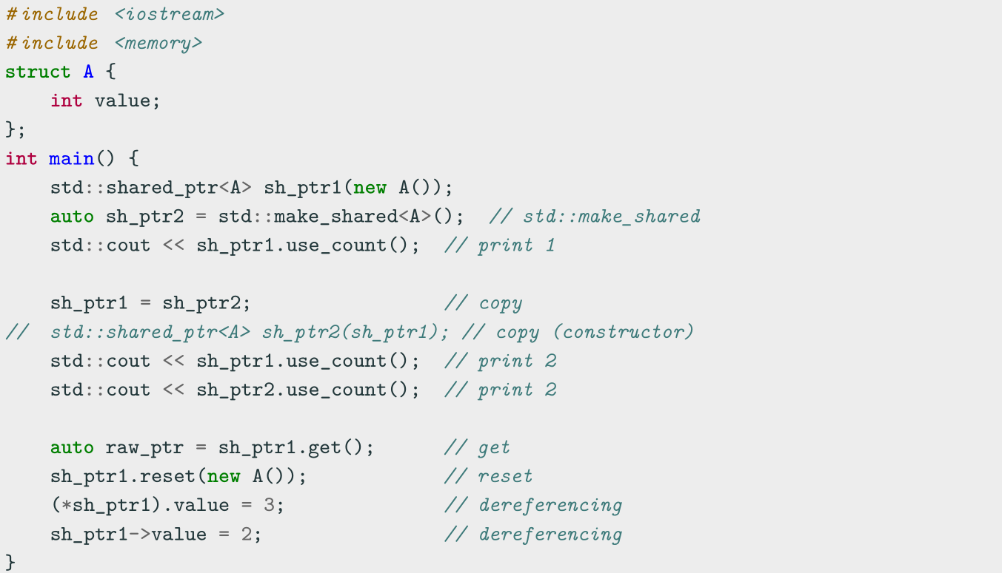
std::shared ptr - Shared Pointer

Slide 18
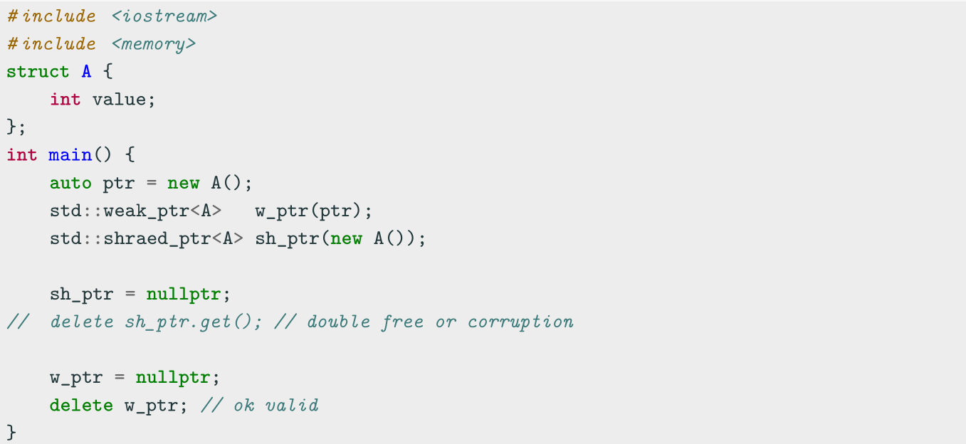
std::weak ptr - Weak Pointer
A std::weak ptr is simply a std::shared ptr that is allowed to dangle (pointer not deallocated)

Slide 19
std::weak ptr - Weak Pointer
It must be converted to std::shared ptr in order to access the referenced object
std::weak ptr methods
• use count() returns the number of objects referring to the same managed object
• reset(ptr) replaces the managed object with ptr
• expired() checks whether the referenced object was already deleted (true, false)
• lock() creates a std::shared ptr that manages the referenced object

Slide 20
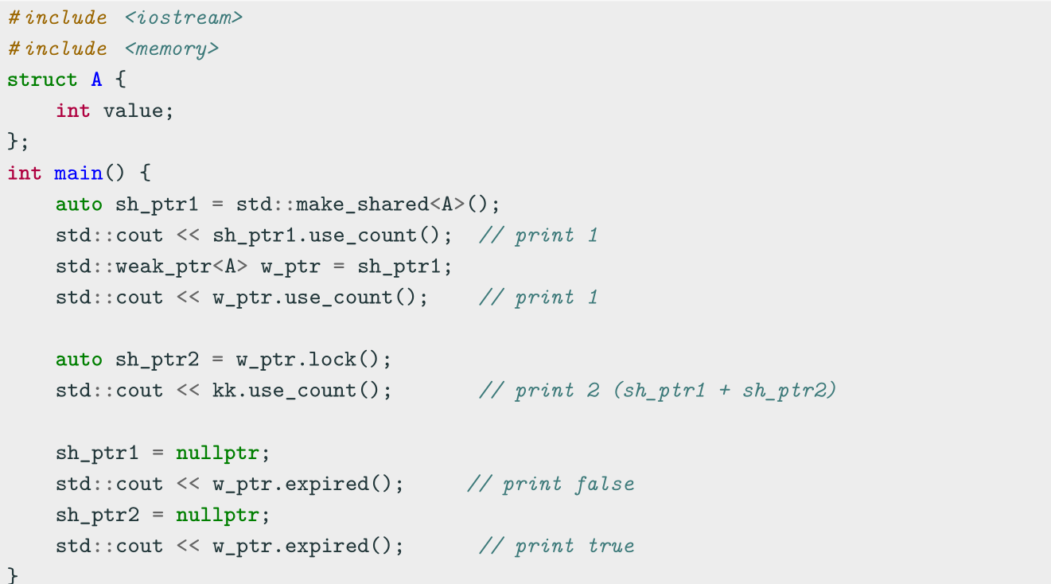
std::weak ptr - Weak Pointer

Slide 21
2. Class Hierarchy
Child/Derived Class or Subclass
A new class that inherits variables and functions from another class is called a derived or child class
Parent/Base Class
The closest class providing variables and functions of a derived class is called parent or base class
Extend a base class refers to creating a new class which retains characteristics of the base class and on top it can add (and never remove) its own members

Slide 22
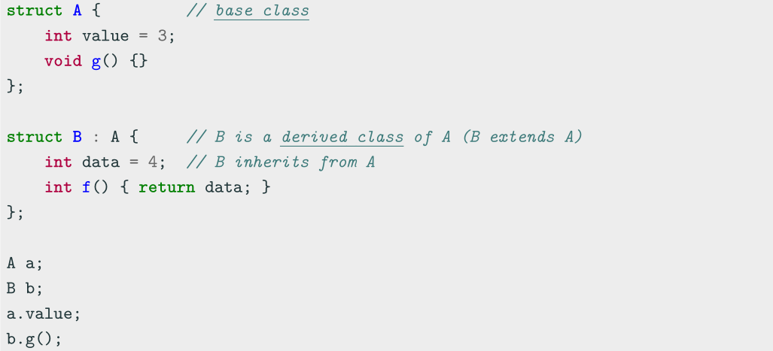
Class Hierarchy

Slide 23
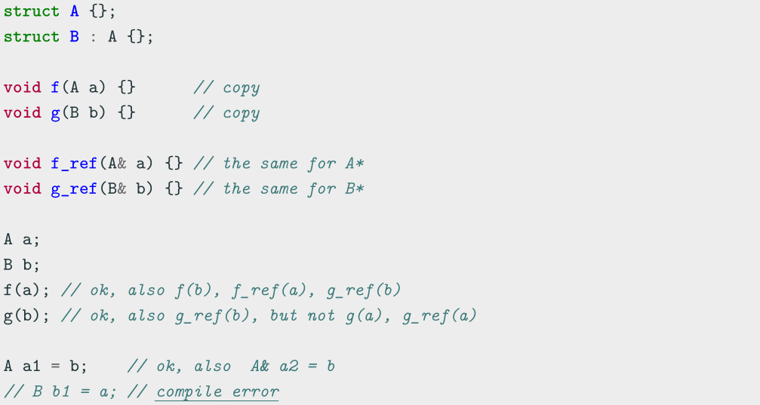
Class Hierarchy

Slide 24
2.1 Access specifiers
The access specifiers define the visibility of inherited members of the subsequent base
class. The keywords public , private , and protected specify the sections of visibility
The goal of the access specifiers is to prevent a direct access to the internal
representation of the class for avoiding wrong usage and potential inconsistency
(access control)
• public: No restriction (function members, derived classes, outside the class)
• protected: Function members and derived classes access
• private: Function members only access (internal)
struct has default public members
class has default private members

Slide 25
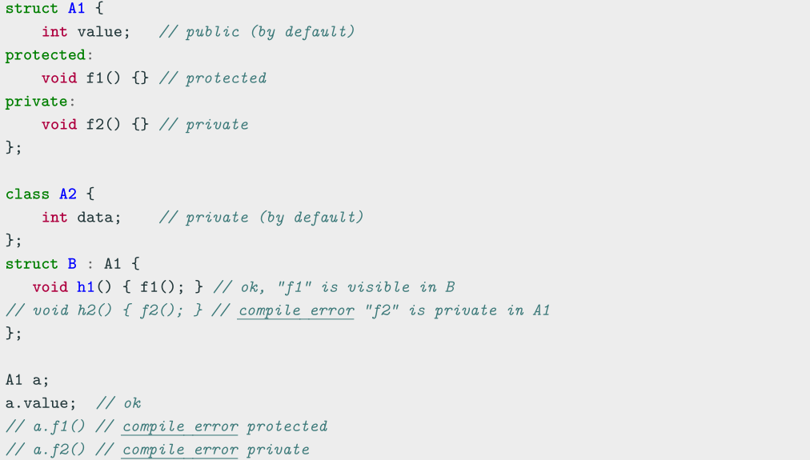
Access specifiers

Slide 26
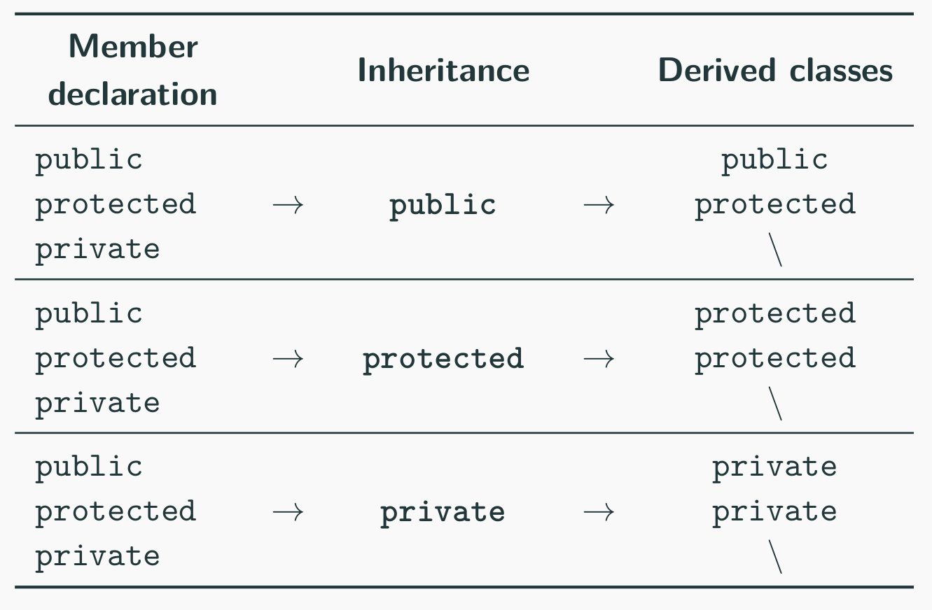
2.2 Inheritance Access Specifiers
The access specifiers are also used for defining how the visibility is propagated from the base class to a specific derived class in the inheritance

Slide 27
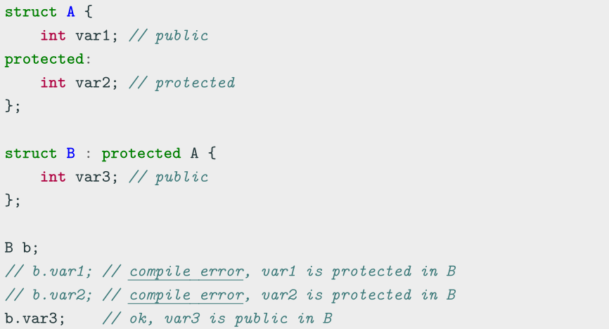
Inheritance Access Specifiers

Slide 28
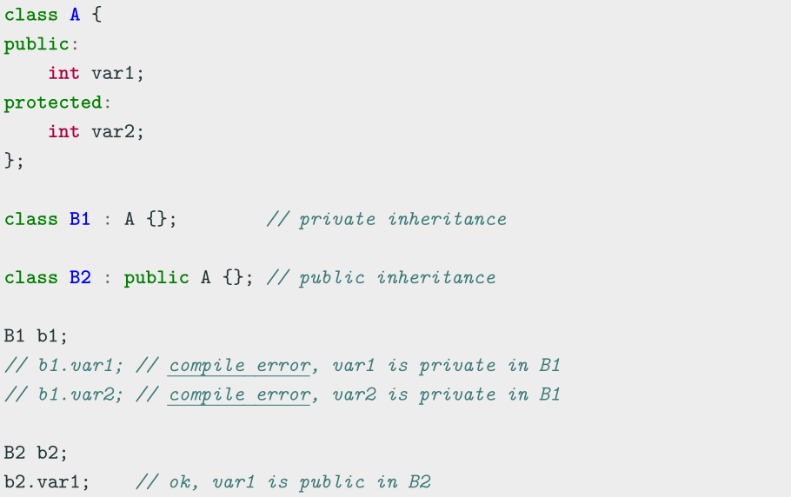
Inheritance Access Specifiers

Slide 29
3. Class Constructor and Destructor
3.1 Intro
Constructor [ctor]
A constructor is a special member function of a class that is executed when a new instance of that class is created Goals: initialization and resource acquisition Syntax: T(...) same named of the class and no return type
• A constructor is supposed to initialize all data members
• We can define multiple constructors with different signatures
• Any constructor can be constexpr

Slide 30
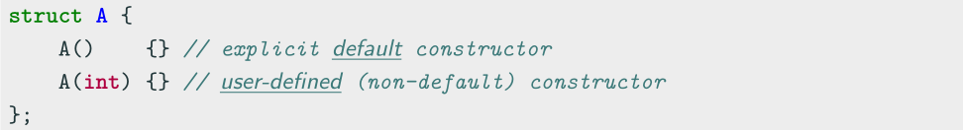
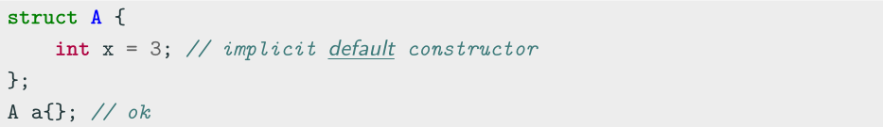
3.2 Default Constructor
Default Constructor
The default constructor T() is a constructor with no argument
Every class has always either an implicit or explicit default constructor
• An implicit default constructor is constexpr

Slide 31
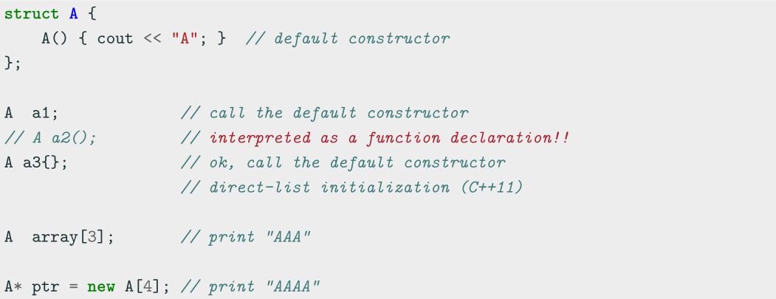
Default Constructor Examples

Slide 32
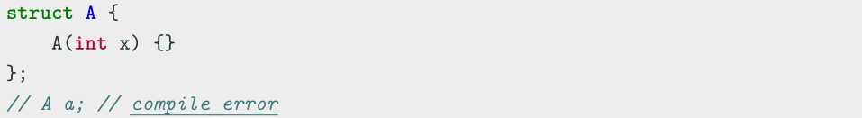
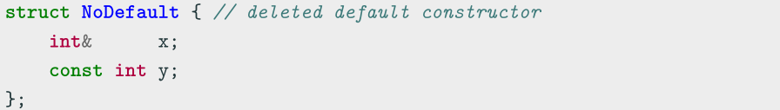
Deleted Default Constructor
The implicit default constructor of a class is marked as deleted if (simplified):
It has any user-defined constructor
It has a non-static member/base class of reference/const type

Slide 33
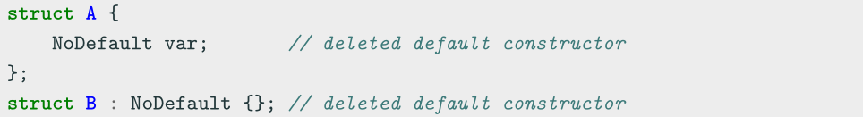
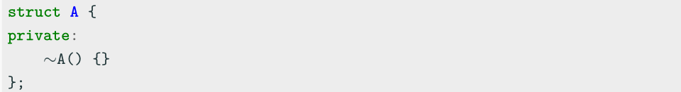
Deleted Default Constructor
It has a non-static member/base class which has a deleted (or inaccessible) default constructor
It has a non-static member/base class with a deleted or inaccessible destructor

Slide 34
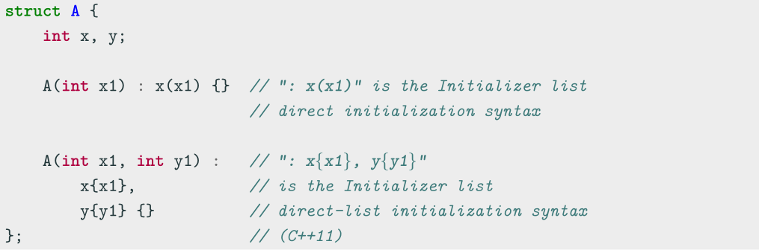
3.3 Class Initialization
3.3.1 Initializer List
The Initializer list is used for initializing the data members of a class or explicitly call
the base class constructor before entering in the constructor body
(Not to be confused with std::initializer list )

Slide 35
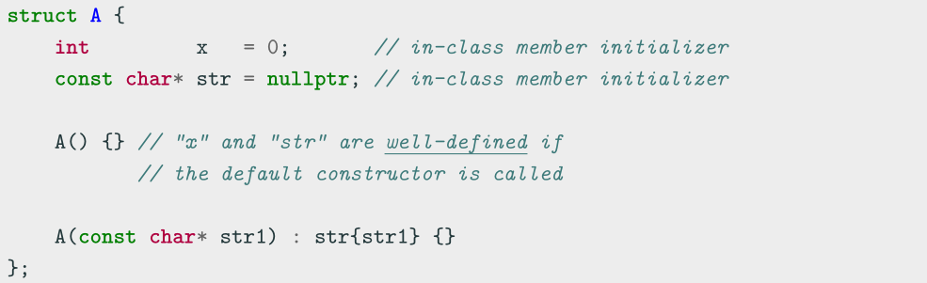
3.3.2 In-Class Member Initializer
C++11 In-class non-static data members can be initialized where they are declared
(NSDMI). A constructor can be used when run-time initialization is needed

Slide 36
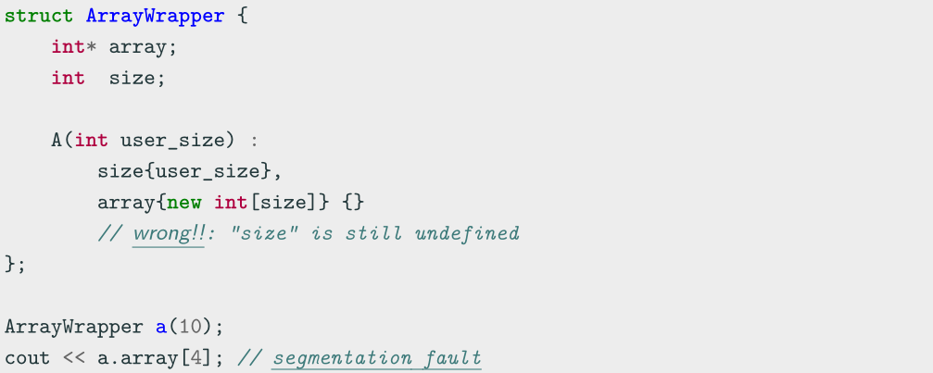
3.3.3 Initialization Order
Class members initialization follows the order of declarations and not the order in the
initialization list

Slide 37
3.3.4 Uniform Initialization
Uniform Initialization ( C++11 )
Uniform Initialization {}, also called list-initialization, is a way to fully initialize any object independently from its data type
Minimizing Redundant Typenames
- In function arguments
- In function returns
Solving the “Most Vexing Parse” problem
- Constructor interpreted as function prototype

Slide 38
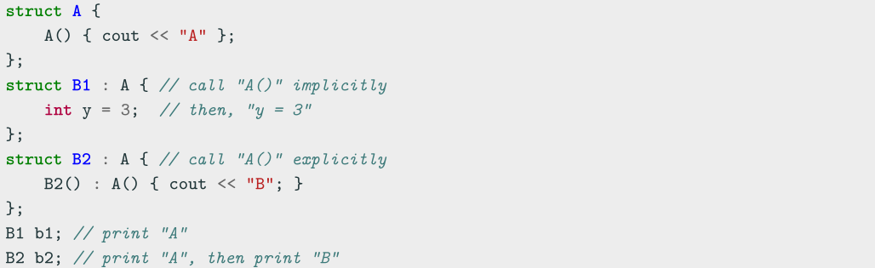
3.4 Constructors and Inheritance
Class constructors are never inherited
A Derived class must call implicitly or explicitly a Base constructor before the current
class constructor
Class constructors are called in order from the top Base class to the most
Derived class (C++ objects are constructed like onions)

Slide 39
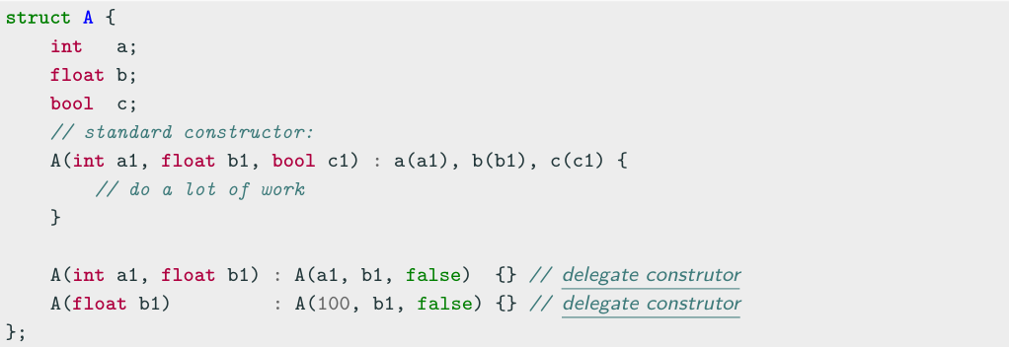
3.5 Delegate Constructor
The problem:
Most constructors usually perform identical initialization steps before executing
individual operations
C++11 A delegate constructor calls another constructor of the same class to reduce
the repetitive code by adding a function that does all of the initialization steps

Slide 40
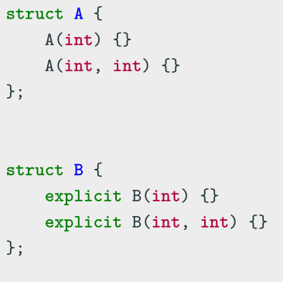
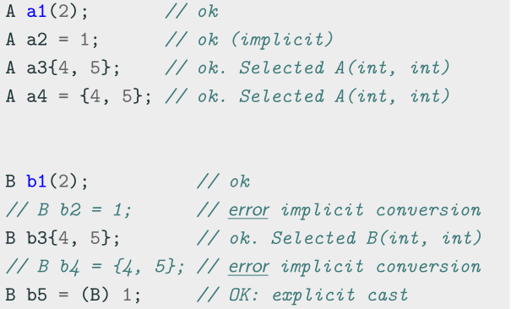
3.6 explicit Keyword
explicit
The explicit keyword specifies that a constructor or conversion function (C++11) does not allow implicit conversions or copy-initialization

Slide 41
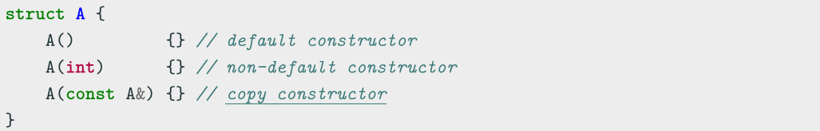
3.7 Copy Constructor
Copy Constructor
A copy constructor T(const T&) creates a new object as a deep copy of an existing object
Every class always defines an implicit or explicit copy constructor
Even the copy constructor implicitly calls the default Base class constructor
Even the copy constructor is considered a non-default constructor

Slide 42
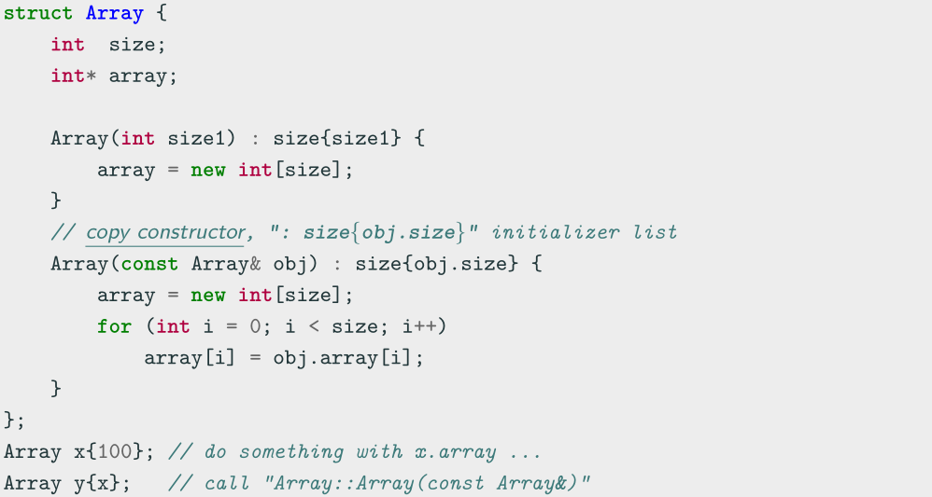
Copy Constructor Example

Slide 43
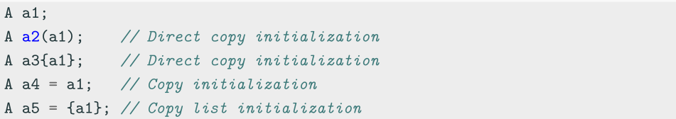
Copy Constructor Usage
The copy constructor is used to:
Initialize one object from another one having the same type
- Direct constructor
- Assignment operator
Copy an object which is passed by-value as input parameter of a function
Copy an object which is returned as result from a function

Slide 44
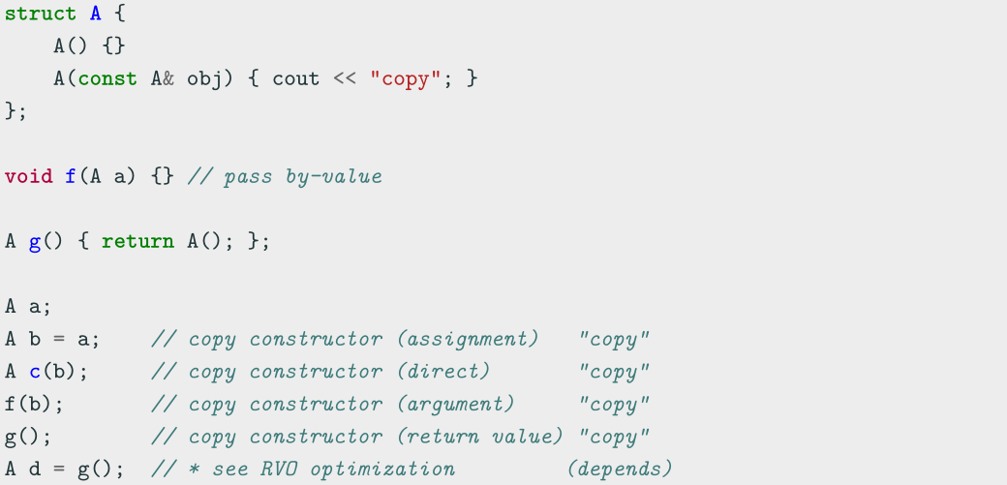
Copy Constructor Usage Examples

Slide 45
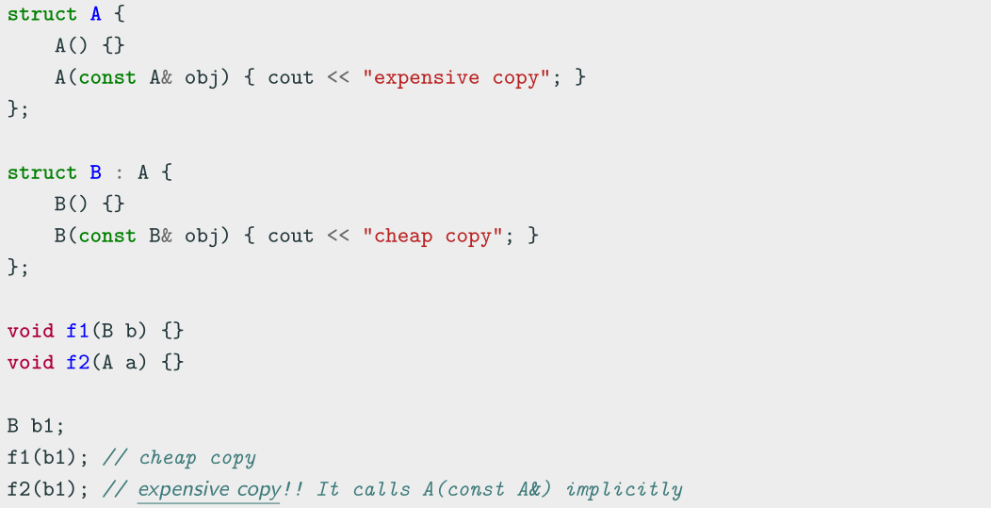
Pass by-value and Copy Constructor

Slide 46
3.8 Move Constructor
Is copying enough?
We’ve learned about the default constructor, destructor, and the copy constructor and assignment operator.
● We can create an object, get rid of it, and copy its values to another object!
● Is this ever insufficient?

Slide 47
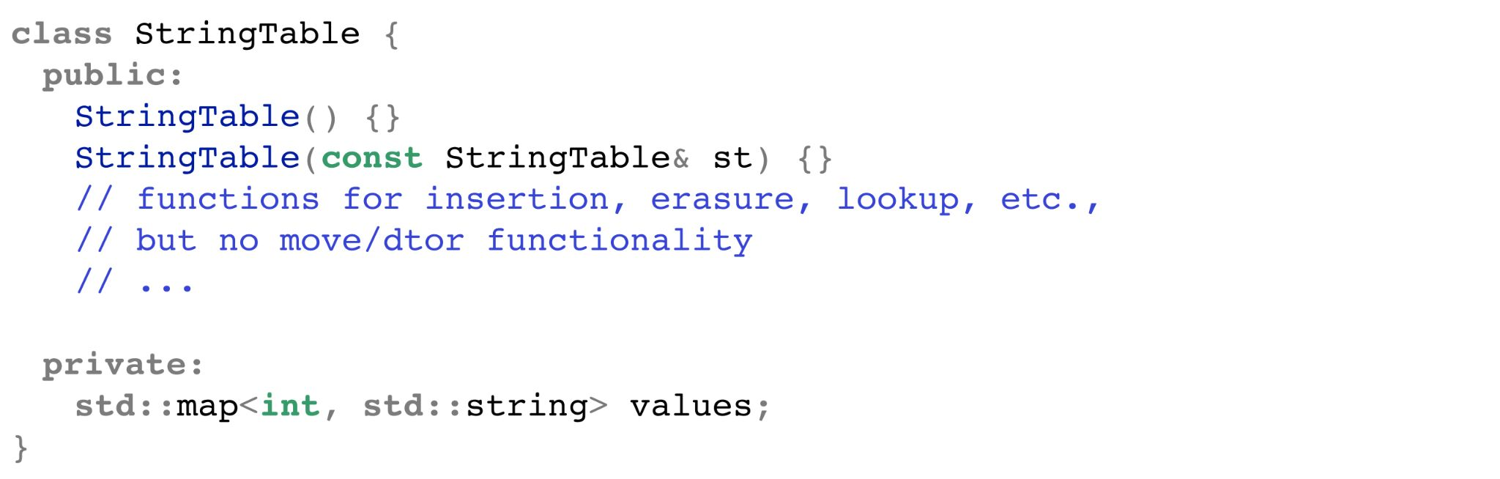
This can be wasteful!
Let's say we had to copy our current StringTable into another, whose reference is
given to us, and we have no use for our StringTable afterwards.
The copy constructor will
copy every value in the
values map one by one!
Very slowly!

Slide 48
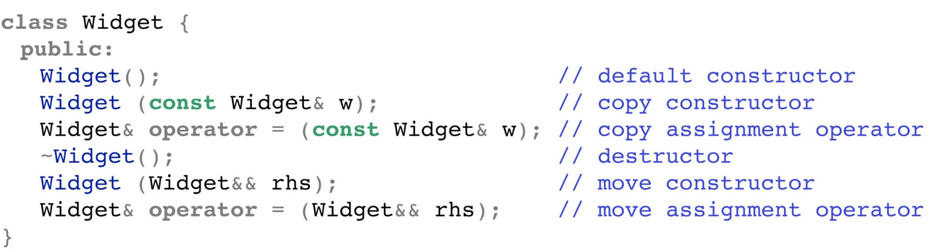
There are six special member functions!
These functions are generated only when they're called (and
before any are explicitly defined by you):
Let’s talk about it now!

Slide 49
Move operations
● Move constructors and move assignment operators will
perform "memberwise moves."
● Defining a move assignment operator prevents generation of a move copy constructor, and vice versa.
○ If the move assignment operator needs to be re-implemented, there'd likely be a problem with the move constructor!
Unlike copy operations!

Slide 50
Caveats
Move constructors and operators are only generated if:
● No copy operations are declared
● No move operations are declared
● No destructor is declared
Declaring any of these will get rid of the default C++ generated operations.

Slide 51
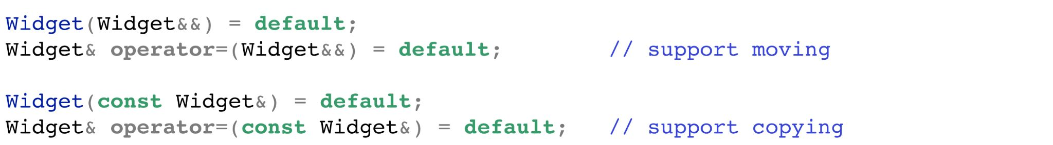
Caveats
If we want to explicitly support move operations, we can set the operators to default:
???

Slide 52
Coding for love, Coding for the world
Qijun Zhao
qjzhao@scu.edu.cn

